Slide 1

Nigeria’s Economic Growth in the Past and Possible Future

Slide 2
TABLE OF CONTENTS
INTRODUCTION
PROJECT OVERVIEW
RESEARCH QUESTIONS
METHODOLOGY
RESULT FINDINGS
POWER BI DASHBOARD
CONCLUSION
RECOMMENDATION

Slide 3
INTRODUCTION

Slide 4
Welcome to my presentation on the analysis of Nigeria’s economic data. Today, I will be sharing insights and trend from a comprehensive data set, exploring the country’s economic performance and growth drivers. We will dive into the relationships between various indicators, including GDP, Inflation rate, Unemployment rate and Government debt rate, to better understand the complexities of Nigeria’s economy. Let’s explore these findings together.

Slide 5
PROJECT OVERVIEW
Examine potential variable’s that could slow down the country’s pace of development
Examine the roles leadership plays in a country’s economic expansion
Identify the key drivers of economic growth and development in Nigeria

Slide 6
RESEARCH QUESTIONS
Was there an increase or decrease in the government debt rate?
Was there an increase or decrease in the inflation rate?
Was there an increase or decrease in the unemployment rate?
To what extent does Net tax on Production contribute to GDP in Nigeria?
What sector contributed the most to the economy?
Does leadership play a role in the country’s expansion?

Slide 7



Methodology
Data Source
Data Cleaning
Data Visualization
Kaggle
Power BI
PowerPoint

Slide 8
RESULT FINDINGS

Slide 9
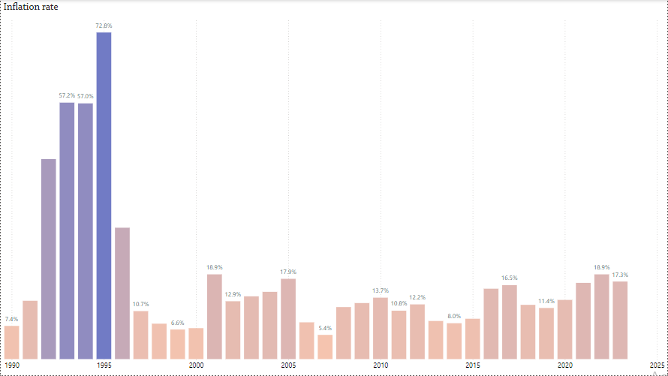
Inflation rate
Maintaining constant prices for goods and services at levels that would not be harmful to the economy is one of the fundamental aims of a modern economic system. We learned from the visualization that the inflation rate reached an all-time high of approximately 72.8% around 1995 but from 2022 Nigeria's inflation rate was 18.9%, up 3.7% from 2020. Inflation for 2020 was 13.2%, up 1.85% from 2019. 11.4% in 2019 was a 0.7% decrease from 2018. 12.1%, a decrease of 4.43% from 2017.

Slide 10
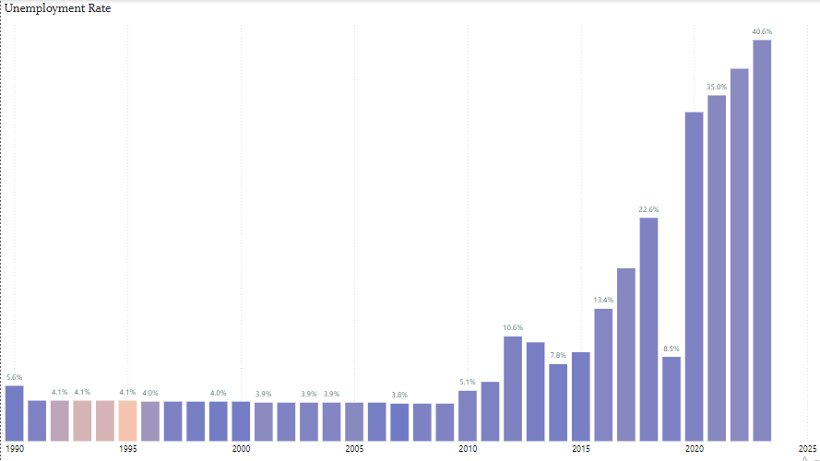
Unemployment rate
The number of persons actively looking for work in Nigeria is expressed as a proportion of the labor force. Nigeria's unemployment rate rose from 33.30% in 2020 to 37.7 % in 2022.

Slide 11
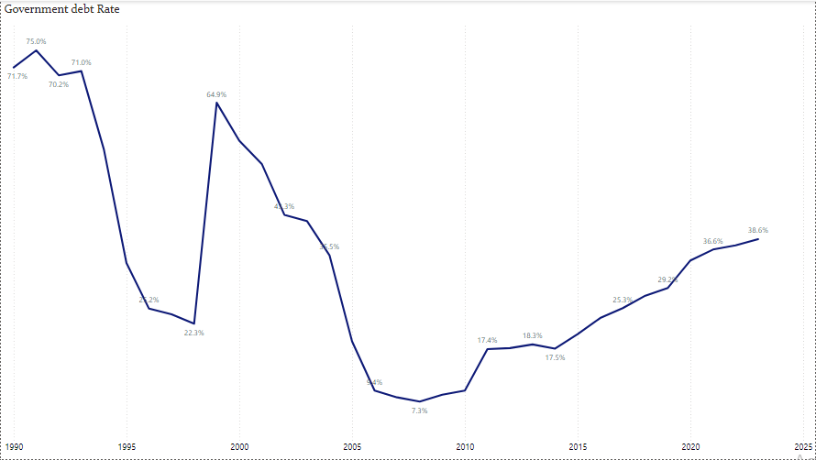
Government debt rate
The highest percentage rate of Nigeria's national government debt was 75% in 1991, while the lowest figure was 7.3% in 2008. Between 2008 and 2023, the debt rate grew, going from 7.3% to about 38.6% at the current time.

Slide 12
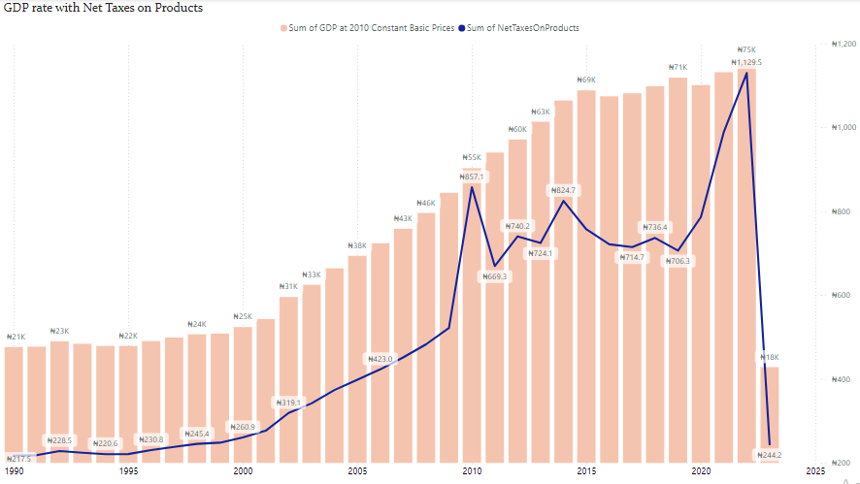
GDP with Net Tax on Production
Net Tax on production is added to the value of goods and services produced(GDP) to calculate the GDP at market prices, and this means an increase in NTOP will lead to an increase in GDP. Also, as GDP grows, NTOP is more likely to increase as a larger economy generates more tax revenue.
N.B: Hight NTOP can reduce GDP growth, as high taxed may discourage production and investment.
As we can see on the analysis where in 2022 had the highest Net Tax on production with 1,129 billion naira leading to a decrease in GDP in 2023 to 17,750 billion naira from 74,639 billion naira in 2022.

Slide 13
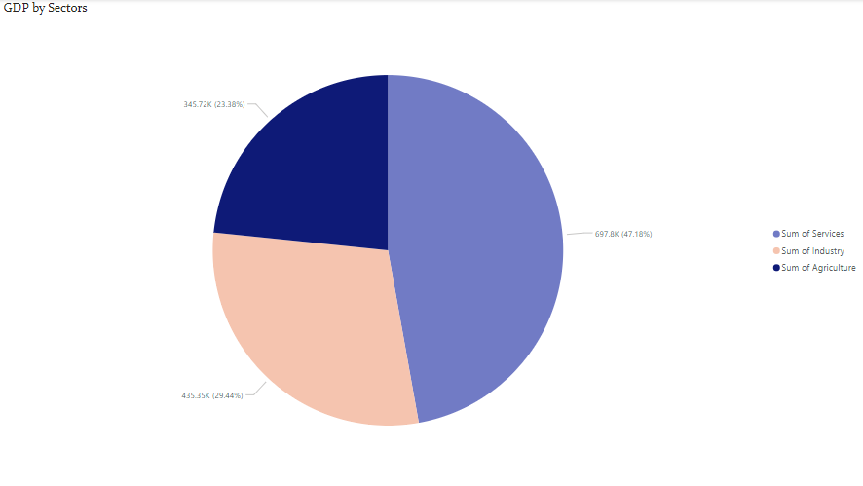
GDP by Sectors
The Service sector’s impact on Nigeria’s economy can’t be overstated. As we can see from the analysis The Agriculture sector contributed the least, about 345,722 billion naira which was about 23%; The Industry sector contributed about 435,249 billion naira which was about 29%; and finally the Service sector contributed the most which was about 697,803 billion naira which was about 47%.

Slide 14
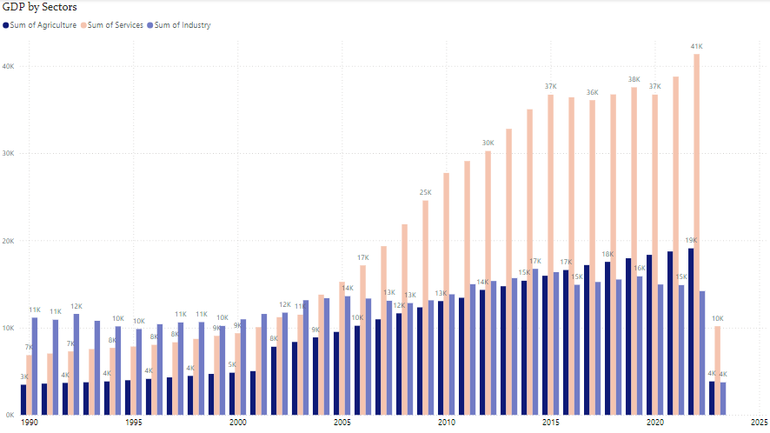
GDP by Sectors
According to the data analysis, there were significant changes in the GDP of each sector listed, demonstrating how Nigeria had neglected the agricultural sector, which was the lowest from 1990 to 2016, but began improving faster than the industry sector from 2016 to present. The service sector has always been the most important sector for generating high GDP in Nigeria, and according to 2022 data, we had roughly 41,352 billion naira in GDP for the Service sector, 19,091 billion naira in GDP for the Agricultural sector, and 14,196 billion in GDP for the Industrial sector. Real Gross Domestic Product (Billion Naira)

Slide 15
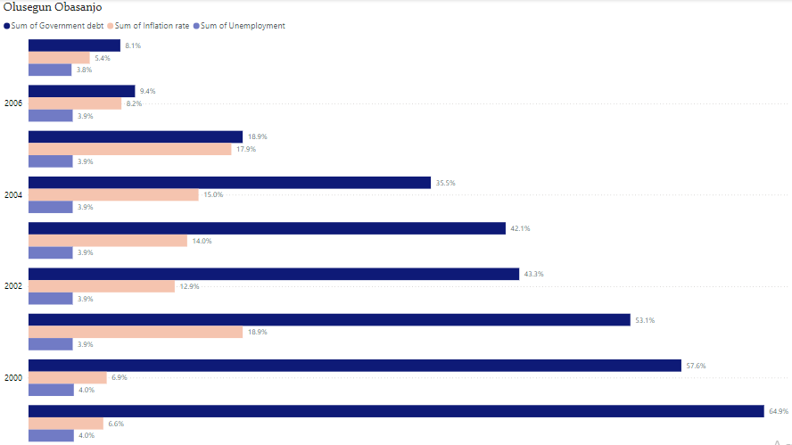
Olusegun Obasanjo (1999-2007)

Slide 16
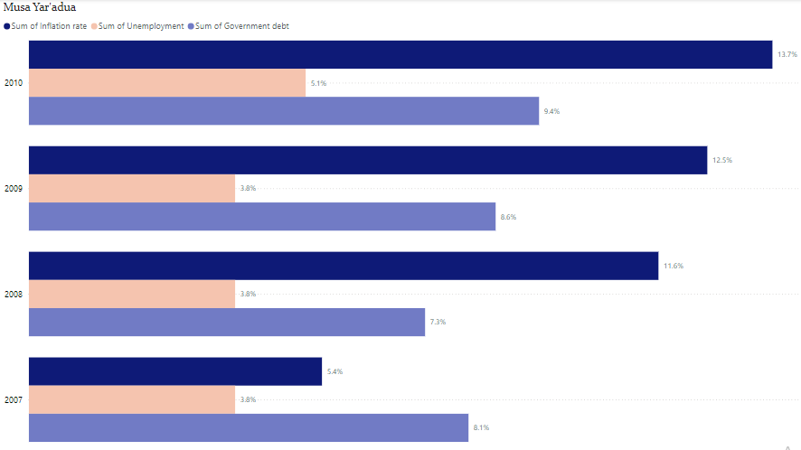
Musa Yar’Adua(2007-2010)

Slide 17
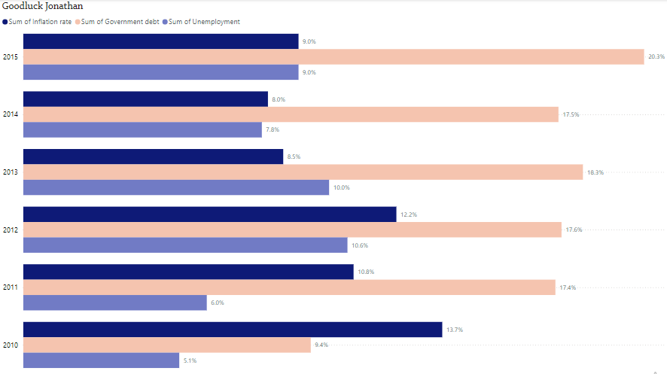
Goodluck Ebele Jonathan(2010-2015)

Slide 18
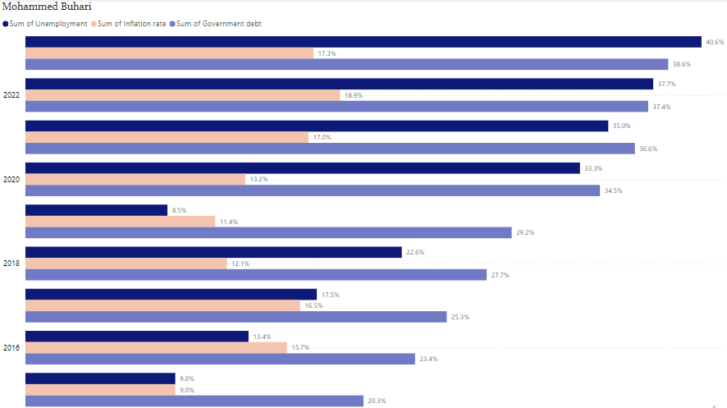
Muhammadu Buhari(2015-2023)

Slide 19
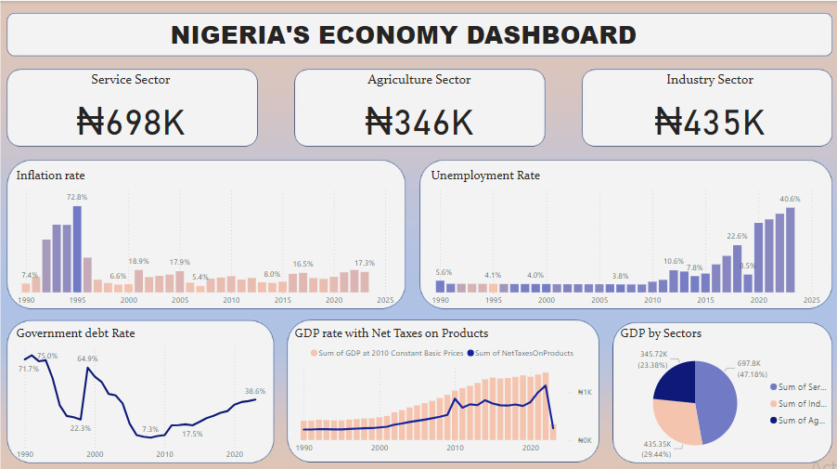
DASHBOARD

Slide 20
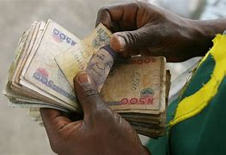
CONCLUSION
In conclusion, we can observe that the leader and their leadership style have a large influence on the growth of any nation. Nigeria has the largest economy in Africa, but the rate at which it is dropping is worrying, and if nothing is done to solve it, we may face a recession that will take time to recover from. Remember that leadership has an impact on a country's economy, thus electing an effective leader has the potential to increase the country's economic growth.

Slide 21
RECOMMENDATION
Electing an effective leader has the potential to increase the country's economic growth.
The government should consider implementing policies to optimize Net Tax on Production, balancing revenue needs with economic growth goals
The private sector should be incentivized to invest in industries with high growth potential
Consider implementing policies to attract foreign investment and promote economic diversification

Slide 22
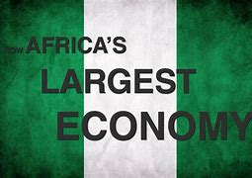
THANK YOU

